Slide 1
Going Round and Round: the Repetition Structure
Chapter 4

Slide 2
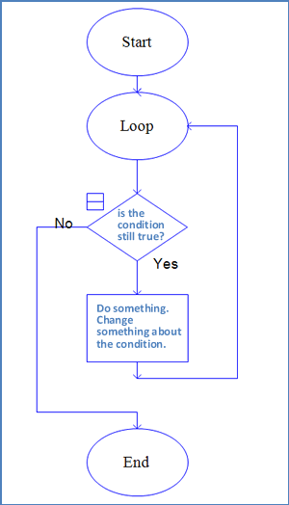
4.1
Computers Don’t Get Bored with Repetition

Slide 3

Loop Basics
Set a variable equal to 1
Begin the loop
Test to see if the variable is less than 4.
If the variable is less than 4:
{
Do some stuff.
Increase the value of
the variable by 1.
Go back to line 3 and
start again.
}
If the condition is no longer true, go to the next line.

Slide 4
Iterations
The number of times a task is repeated is important
In computer lingo, a single pass through a loop is called a loop iteration.
A loop that executes 3 times goes through 3 iterations.

Slide 5
Beware the Infinite Loop!
Declare two integer variables, num1 and num2
Begin the loop
{
Get a number from the user, store it in num1
Set num2 = num1 + 1
Display "Hello!"
}
Repeat until num1 > num2
Display “The End”
The test condition is impossible to achieve.
The loop will run forever.

Slide 6
Don’t Get Trapped in a Loop
Declare a string variable, name
Set the initial value of name to " "
Begin the loop: test if name == "done"
{
Ask the user: "Enter your friend's name:"
Store the entry in name
Display name
}
Display “The End”
The test condition is extremely unlikely to be met, unless the user has a friend named done. The user will be trapped and have to enter names forever.

Slide 7
4.2
Types of Loops

Slide 8
Pre-Test and Post-Test Loops
The general form of a pre-test loop is as follows:
Is some condition true? If yes, enter the loop: → Test here!
{
Do some stuff
}
Program continues
The general form of a post-test loop is as follows:
Enter the loop:
{
Do some stuff
}
Is some condition true? If yes, go back to line 1 → Test here!
Program continues

Slide 9
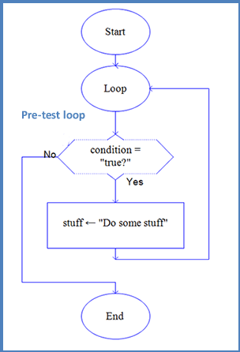
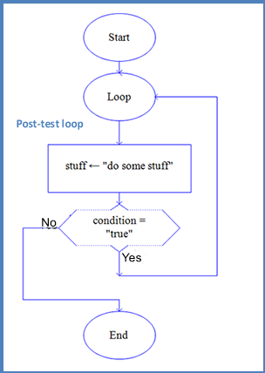
Pre-Test and Post-Test Loops

Slide 10
Valid Test Conditions
If num1 is a numeric variable: num1 >= 100;
If myChoice is a string variable: myChoice < 3;
If num2 is a numeric variable: 14 > num2;
If response is a string variable: response != "no";
If num3 is a numeric variable: num3 = 15;
Answers:
valid -- It asks the question, "Is num1 greater than or equal to 100?" and will always be answered by either true or false.
not valid -- Since myChoice is a string variable, it cannot be less than the integer 3. However, myChoice < "3"; is a valid test condition.
not valid -- The left side of the condition must always be a variable.
valid -- The answer to the question, "Is the value of response not the same as the string "no"? will always be either true or false.
not valid -- The statement num3 = 15; does not ask a question. It is an assignment statement and assigns the value 15 to the variable num3. num3 == 15; is valid.

Slide 11
Generating a Table with a while loop
1. <html><head> 2. <title>Example 4.7</title> 3. <script> 4. function getPlayers() 5. { 6. var player = prompt("Enter the name of a player:"," "); 7. var points = prompt("Enter the points this player has:"," ");
8. document.write('<table width="40%" border="1">'); 9. while (player != "done") 10. { 11. document.write('<tr>'); 12. document.write('<td width="50">' + player + '</td>'); 13. document.write('<td width = "50">' + points + '</td>'); 14. document.write('</tr>'); 15. player = prompt("Enter the name of a player or enter 'done' when
you're finished:"," ");
16. points = prompt("Enter the points this player has or 0 if
finished:"," ");
17. }
18. document.write('</table>'); 19. } 20. </script> </head><body> 21. <h1>Today's Players</h1> 22. <h3>Click to enter players' names</h3> 23. <p><input type="button" id="players" value="Enter players“ onclick="getPlayers();" />
24. </p> </body></html>

Slide 12
The Post-Test do…while Loop
The general form of a post-test loop is as follows:
Enter the loop:
{
Do some stuff
}
Is some condition true? If yes, go back to line 1 → Test here!
Program continues
This loop will always execute at least once!
When should you use a post-test loop over a pre-test loop?
Depends on the situation.
A shopping cart should use a pre-test loop so the customer is not forced to order at least 1 item.
A program that only runs when there is at least one entry (such as payroll for a business) might use a post-test loop.

Slide 13
Using a do...while loop for payroll
1.<html> <head> 2.<title>Example 4.9</title> 3.<script> 4. function getPay() { 5. document.write('<table width="40%" align = "center">'); 6. var name = " "; var hours = 0; var rate = 0; var grossPay = 0; var netPay = 0; 7. document.write('<tr><td>name</td><td>gross pay</td><td>net pay</td></tr>');
8. name = prompt("Enter the first employee's name:");
9. do { 10. hours = parseFloat(prompt("How many hours did " + name + " work this week?"));
11. rate = parseFloat(prompt("What is " + name + "'s hourly pay rate?"));
12. if (hours > 40) 13. grossPay = (40 * rate) + ((hours - 40) * 1.5 * rate); 14. else 15. grossPay = hours * rate; netPay = grossPay * .85; 16. document.write('<tr><td>' + name + '</td><td>$ ' + grossPay + '</td><td>$ ' + netPay + '</td></tr>');
17. name = prompt("Enter another employee's name or enter 'done' when finished:");
18. } while (name != "done") 19. document.write('</table>'); 20. } 21.</script> </head> 22.<body> 23. <h1>Calculate Employees Paychecks</h1> 24. <p>You can enter payroll information for all employees. Paychecks are calculated as shown:</p>
25. OUTPUT GOES HERE 26. <p><input type="button" id="pay" value="Click to begin entering employees" onclick="getPay();" /></p>
27.</body> </html>

Slide 14
Formatting Output
The toFixed() Method
num.toFixed(x)
where num is a numeric variable and x is the number of places to be represented.
If num = 3.1415926536
num.toFixed(2) = 3.14
num.toFixed(5) = 3.14159
num.toFixed(11) = 3.14159265360

Slide 15
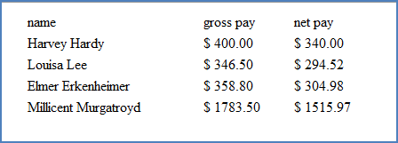
Payroll Program Output
By adding .toFixed(2) to the variables grossPay and netPay in the code in the previous example, the output would now look like this:

Slide 16
Sentinel Controlled Loops: The sentinel is a signal that input is complete.
1. <html> <head> 2. <title>Example 4.10</title> 3.<script> 4. function getClass() { 5. document.write('<table width="40%" align = "center">'); 6. var fname = " "; var lname = " "; var id = " "; var username = 0; var course = " "; 7. course = prompt("What is the name of this course?"); 8. document.write('<tr><td colspan =4 align = "center">' + course + '</td></tr>');
9. document.write('<tr><td>first name</td><td>last name</td><td>ID number</td><td>username</td></tr>');
10. fname = prompt("Enter one student's first name:"); 11. lname = prompt("Enter the student's last name:"); 12. id = prompt("Enter the student's identification number:"); 13. do { 14. username = fname + id; 15. document.write('<tr><td>'+fname+'</td><td>+lname+'</td><td>+id+'</td><td>'+username+'</td></tr>');
16. fname = prompt("Enter another student's first name or enter 'X' when finished:");
17. lname = prompt("Enter another student's last name or enter 'X' when finished:");
18. id = prompt("Enter another student's identification number or enter -9 when finished:");
19. } while (id != -9) 20. document.write('</table>'); 21. } 22. </script></head> 23. <body> 24. <table align ="center" width ="70%"><tr><td colspan ="2"> <h1>Create Usernames</h1> 25. <p>You can enter each student's name and ID number and <br /> this program will create usernames for you</p>
26. <tr><td><p>&nbsp;</p> 27. <p><input type="button" id="username" value="Click to begin entering names" onclick="getClass();" /></p>
28. </td></tr> </table> </body> </html>

Slide 17
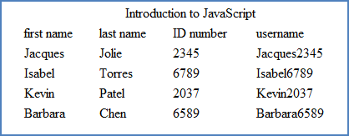
Student ID Program Output
Input:
Course Name: Introduction to JavaScript
Students:
Jacques Jolie, ID: 2345
Isabel Torres, ID: 6789
Kevin Patel, ID: 2037
Barbara Chen, ID: 6589
X X, ID: -9

Slide 18
Formatting Output
The toLowerCase() and toLowerCase() Methods
name.toLowerCase()
name.toUpperCase()
where name is a string variable
If name = “Joey”
name.toLowerCase() = “joey”
name.toUpperCase() = “JOEY”

Slide 19
Counter-Controlled Loops
A counter-controlled loop contains a variable (the counter) that keeps track of the number of passes through the loop (the iterations).
When the counter reaches a preset value, the loop is exited.
In order for the computer to execute the loop a certain number of times, it must keep track of how many times it goes through the loop.

Slide 20
Using a Counter
Define a counter:
The counter is a variable.
It is always an integer
Common variable names for counters are counter, count, i, or j.
In some languages words like count or counter can be keywords.
Best to name your counter something very simple, like i or j.
Initialize the counter:
Set the counter to a beginning value.
The counter can begin at any integer value—often determined by other factors in the program
We will usually set our counter equal to 0 or 1.
Increment (or decrement) the counter:
To increment by ones: i = i + 1.
Use shortcut operators

Slide 21
Shortcut Operators
Beginning Value of j | Increment/Decrement Expression | Shortcut | Ending Value of j
1 | j = j + 1 | j++ | 2
1 | j = j – 1 | j-- | 0
5 | j = j + 2 | j+=2 | 7
5 | j = j – 2 | j-=2 | 3
4 | j = j * 3 | j*=3 | 12
4 | j = j / 2 | j/=2 | 2
1 | j = j + 1 | ++j | 2

Slide 22
4.3
The for Loop

Slide 23
General Form: the for statement
for (counter = initialValue; test condition; increment/decrement)
{
body of the loop;
}
The Initial Value
The first statement sets the counter to its initial value.
The initial value can be any integer constant, such as 1, 0, 23, or –4.
The initial value can also be another numeric variable.
The Test Condition
The test condition asks the question, “Is the counter within the range specified by this condition?”
In a for loop, the test condition is checked at the beginning. After the loop body executes once, the counter is then either incremented or decremented and the test condition is checked again.
The test condition is checked each time after the body of the loop has completed.
The Increment/Decrement Statement
The increment or decrement statement uses shortcut notation.

Slide 24
Examples
1. function countStars() { var i = 0;
var starNum = 4; star = (“*"); for (i = 0; i <= starNum; i++) document.write(star + "&nbsp;"); } Output: * * * * *
2. function countStars() { var i = 0;
var starNum = 4; star = (“*"); for (i = starNum; i >= 0; i--) document.write(star + "&nbsp;"); } Output: * * * * *

Slide 25
Examples
3. function countStars() { var i = 0;
star = (“*"); for (i = 0; i <= 7; i++) document.write(star + "&nbsp;"); } Output: * * * * * * * *
2. function countStars() { var i = 0;
star = (“*"); for (i = 1; i < 7; i++) document.write(star + "&nbsp;"); } Output: * * * * * *

Slide 26
4.4
Data Validation

Slide 27
Making Sure the Entry is Positive
var bracelets = parseInt(prompt("How many bracelets do
you want?"," "));
while (bracelets < 0) { bracelets = prompt("Please enter a positive
number. How many bracelets do you
want?"," ");
} document.write("You are ordering " + bracelets +
" bracelets. Thank you!");

Slide 28
The isNaN() Method
This method returns true if expression or variable inside () is not a number.
Can be combined with previous example to make sure an actual number which is also a positive number is entered.
var bracelets = parseInt(prompt("How many bracelets do
you want?"," "));
while (isNaN(bracelets) || bracelets < 0) { bracelets = prompt("Please enter a positive
number. How many bracelets do you
want?"," ");
} document.write("You are ordering " + bracelets +
" bracelets. Thank you!");

Slide 29
Checking for Integers
The parseInt() method will only truncate the decimal part of a floating point number. To check if a user has entered an integer, use the mod operator.
If a number is an integer, number % 1 has remainder = 0
Putting it all together: check that a user enters a positive integer:
var bracelets = parseInt(prompt("How many bracelets do
you want?"," "));
var check = bracelets % 1;
while(isNaN(bracelets) || (bracelets < 0) || (check != 0)) { bracelets = prompt("Please enter a positive
whole number. How many bracelets
do you want?"," ");
} document.write("You are ordering " + bracelets +
" bracelets. Thank you!");

Slide 30
The charAt() Method
The charAt() method returns the character at a specified index in a string (any text that is enclosed in quotes).
Each character in the string has an index number.
Every character counts. This includes punctuation, spaces, special characters such as '@' or '&'.
The index begins at 0. For example, the 'c' in the string “cat” has index = 0, the 'a' in “cat” has index = 1 and the 't' in “cat” has index = 2.
The charAt() method can be used to locate a particular character in a string

Slide 31
Examples
Given the following string variables:
var myName = "Morty Mort, Jr."
var myAddress = "123 Duckwood Terrace";
(a) myName.charAt(0) = 'M'; | if you have a numeric variable: var j = 4;
(b) myName.charAt(3) = 't'; | (i) myName.charAt(j) = 'y';
(c) myName.charAt(8) = 'r'; | (j) myName.charAt(j + 2) = 'M';
(d) myName.charAt(10) = ',' | (k) myAddress.charAt(j - 3) = '2';
(e) myAddress.charAt(1) = '2'; | (k) myAddress.charAt(j * 2) = 'w';
(f) myAddress.charAt(3) = ' ';
(g) myAddress.charAt(8) = 'w';
(h) myAddress.charAt(14) = 'e'

Slide 32
The length Property
The length property returns the length of a string in characters. When you append this property to a variable, the result is the number of characters in the variable, including all punctuation, special characters, and spaces.
Each character in the string has an index number.
Every character counts. This includes punctuation, spaces, special characters such as '@' or '&'.
The length of any string is simply how many characters are in the string. For example, the string "cat" has length = 3 and the string "Lee Clark owns a cat!" has length = 21.
The length property can be used to tell the programmer how many characters are in any string. To see if a specific character is included in that string, the length property tells how many characters need to be checked or, in programming terms, how many times a loop must iterate.

Slide 33
Examples
if myName = “Persephone“
myName.length = 10
if myName = “Amy Ames“
myName.length = 8
if myAddress = “New York, New York 10002“
myAddress.length = 24
if myAddress = “the big oak tree“
myAddress.length = 16

